Slide 1
Economic opportunities for industrial systems from dynamic electricity markets
Aersi Aierzhati
Data Incubator
Capstone project week 3

Slide 2

Use machine learning model to predict the electricity price
polynomial regression, random forest, decision tree, relevance vector machines and neural network

Slide 3
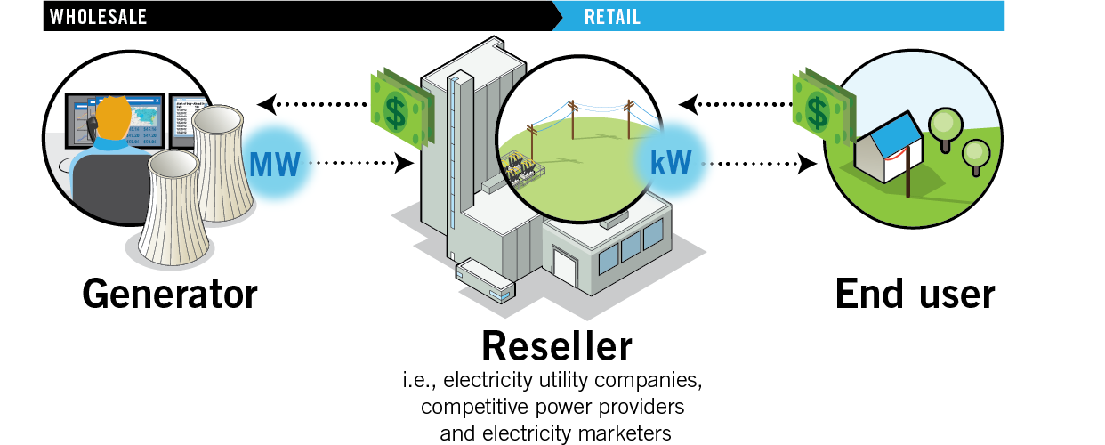
Electricity markets

Slide 4
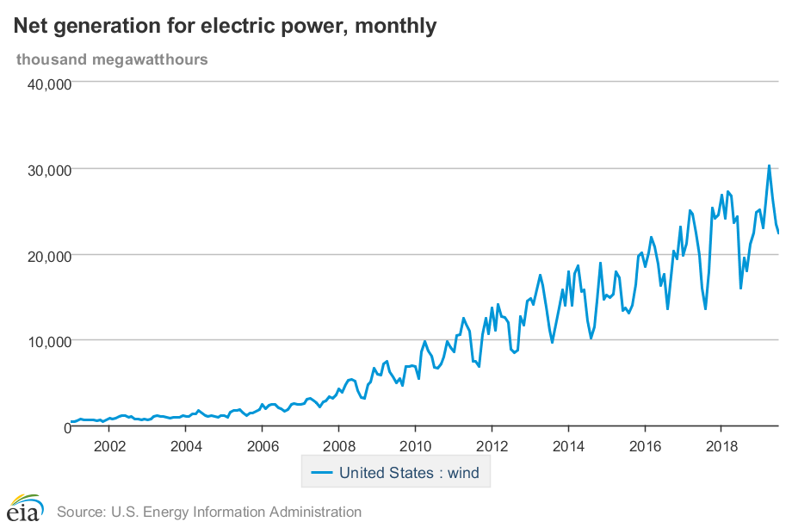
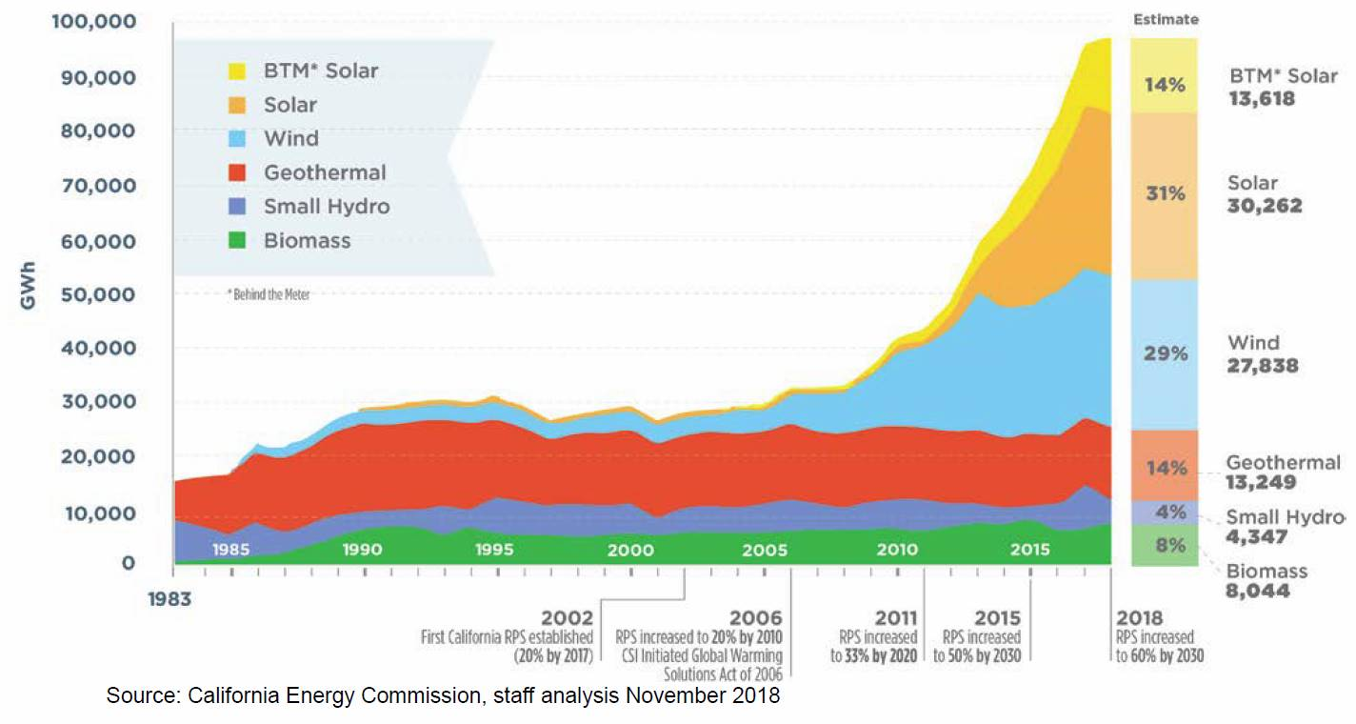
Increasing generation of electricity from Wind

Slide 5
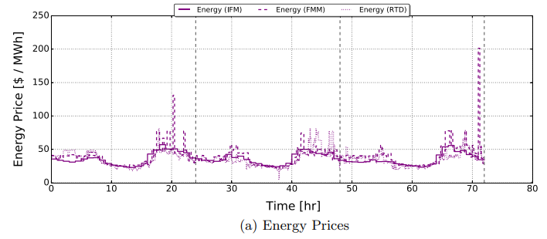
Electricity price fluctuates over time

